Slide 1
Weekly report: Electrical Drivetrain
Week number: 12
Date: 16/12/2025
Supervisor: Prof. Dr.-Ing. Saiju
Group members: Aiswarya Vijayan, Vishranti Shivajirao Patil , Girish Mahadeo Padalkar, Cristina Milene Vergara Hernandez

Slide 2
List of contents
Design Parameter of Converter.
Mechanical Dimension of Converter.
Mat lab simulation model of Converter.
Rotor side converter simulation model.
Grid side converter simulation model.
Result of Converter.
Final cable selection.
Switchgear
Aiswarya Vijayan
Electrical Drivetrain/ Optimus Syria

Slide 3
1. Design parameter of Converter (Updated)
Parameters | Concept
Converter application | DFIG rotor-connected partial-scale back-to-back VSC
Converter topology | 2-level back-to-back Voltage Source Converter (VSC)
Semiconductor device | IGBT (6+6)
Converter input power(Rotor slip power) | 1.03 MW
Converter output power (Grid side) , Pgsc out | 1.009 MW
Ploss | 1.03 – 1.009 = 0.0021 MW = 21 kW
Pgrid,total | 4.12 + 1.01 = 5.13 MW
Converter Rating | 1.14 MVA
Grid filter type | LCL filter
Manufacturer | ABB ACS880-87LC / Hopewind DFIG
Mechanical arrangement | In-line, 2 cabinets (line-styled)
Aiswarya Vijayan

Slide 4
Converter data sheet (Update)
Parameter | Value
Switching frequency, (f_{sw}) | 2500 Hz (2.5 kHz)
Nominal generator/grid voltage, (V_g) | 0.96 kV
DC-link setpoint (VSC), (V_{vsc}) | 1.6 kV
Converter reactance, (X_g) | 0.08 Ω
Converter angle, (\delta) | 10°
LCL filter – converter-side inductance, (L_{f1}) | 0.00035 H (0.35 mH)
LCL filter – filter capacitor, (C_f) | 0.0002 F (200 µF)
LCL filter – grid-side inductance, (L_{f2}) | 0.00025 H (0.25 mH)
DC-link capacitance, (C_{dc}) | 0.02 F (20 mF)
Nominal DC-link current, (I_{dc,nom}) | 643.8 A
Base line current (AC side), (I_{base}) | 688.3 A
Base impedance (AC side), (Z_{base}) | 0.805 Ω
Base inductance at 50 Hz, (L_{base}) | 0.002563 H (2.563 mH)
Aiswarya Vijayan

Slide 5
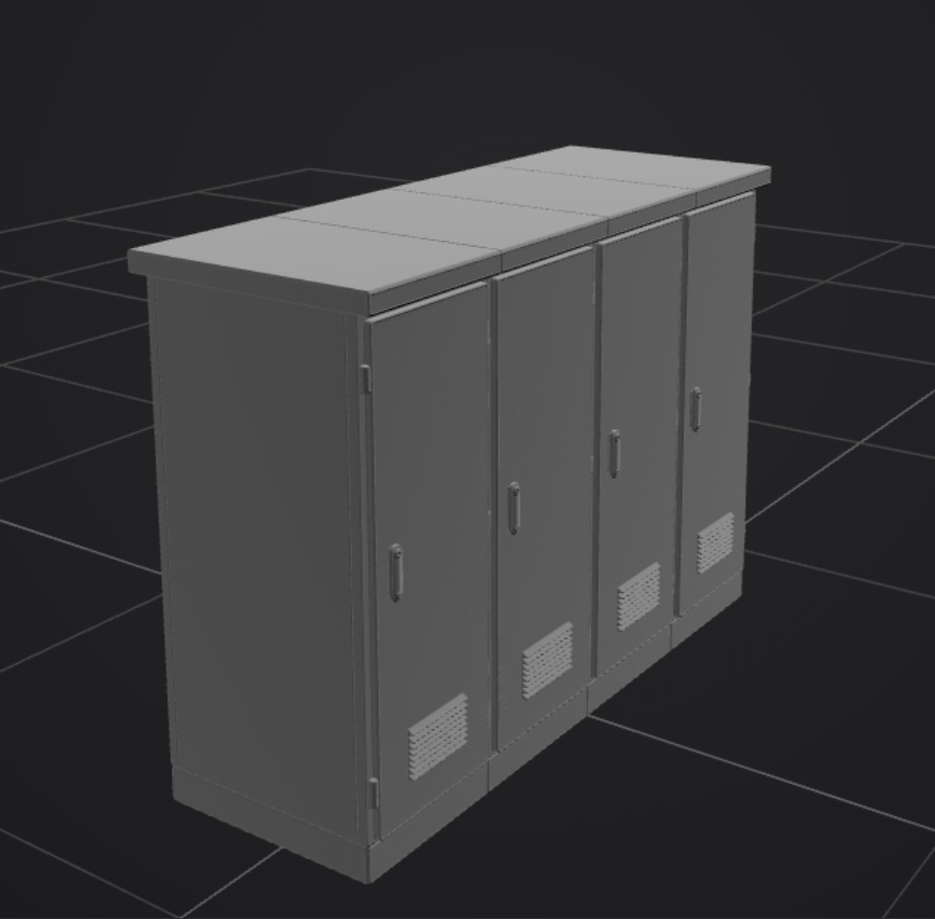
2. Mechanical Dimension of Converter.
1300 * 2000 * 2600 | Converter Dimensions (LxHxW)
~3000 kg | Weight
Liquid Cooling | Cooling
98.0% | Efficiency
€80,000 - €120,000 EUR | Cost
Converter scheme . Source [own]. 06.12.2025
For Dimensions ,Weight , Cost we take reference from: [Source. 4] ,[Source.5] [Source. 6]
Aiswarya Vijayan

Slide 6
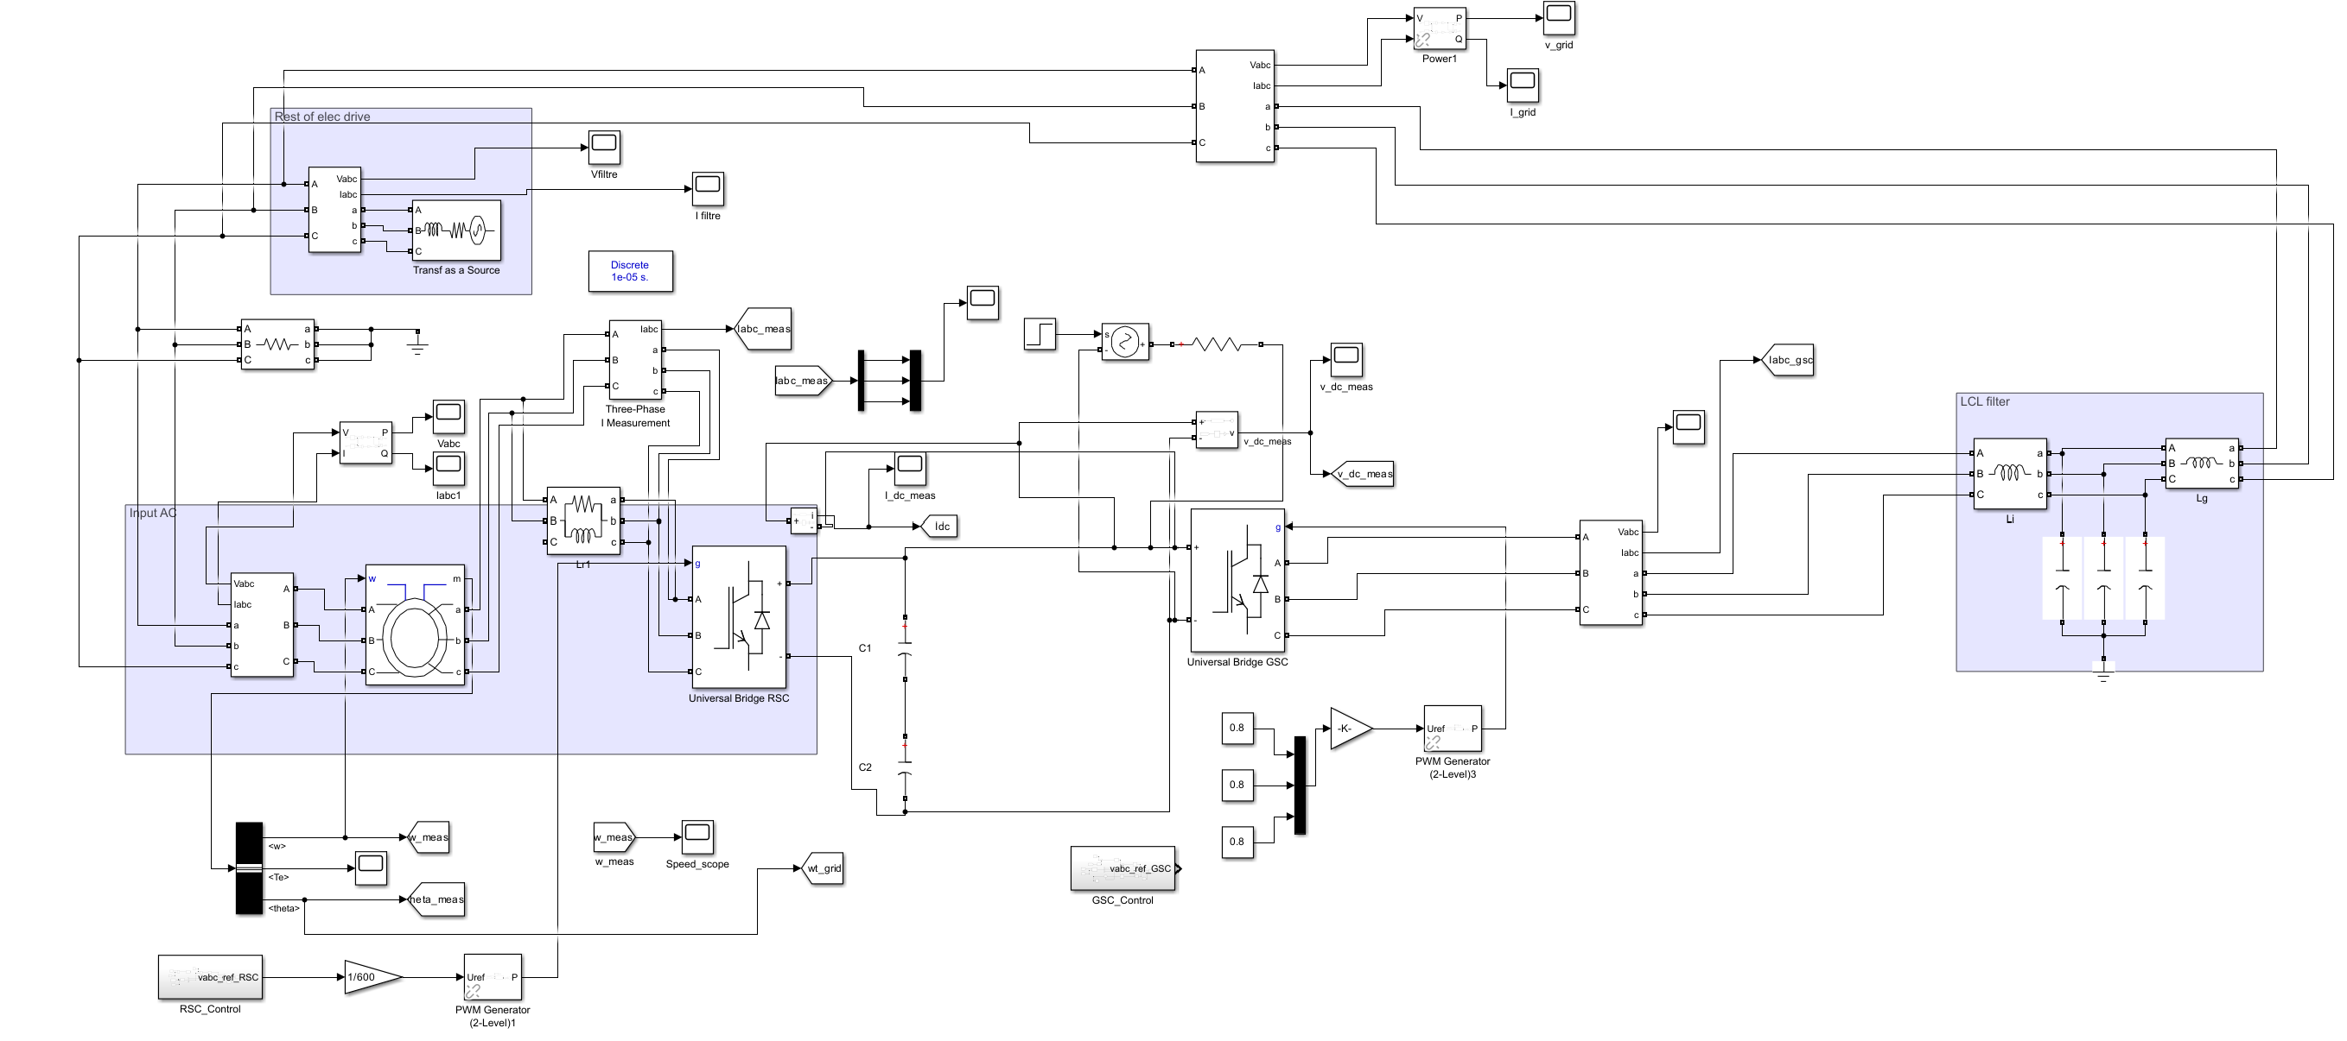
3. Mat lab simulation of Converter
Converter scheme . Source [own]. 06.12.2025
Aiswarya Vijayan

Slide 7
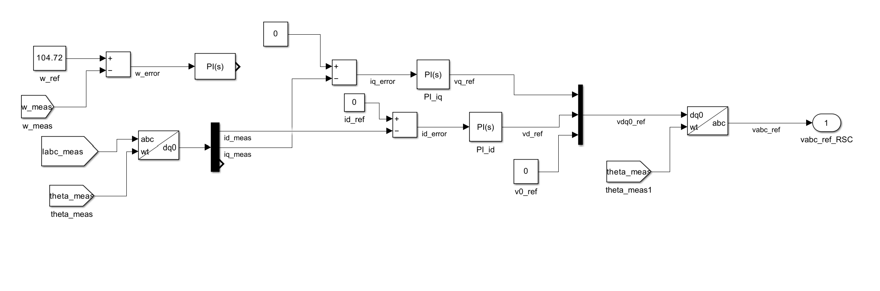
Rotor sidecontrol scheme
Rotor side control scheme . Source [own]. 06.12.2024
Aiswarya Vijayan

Slide 8
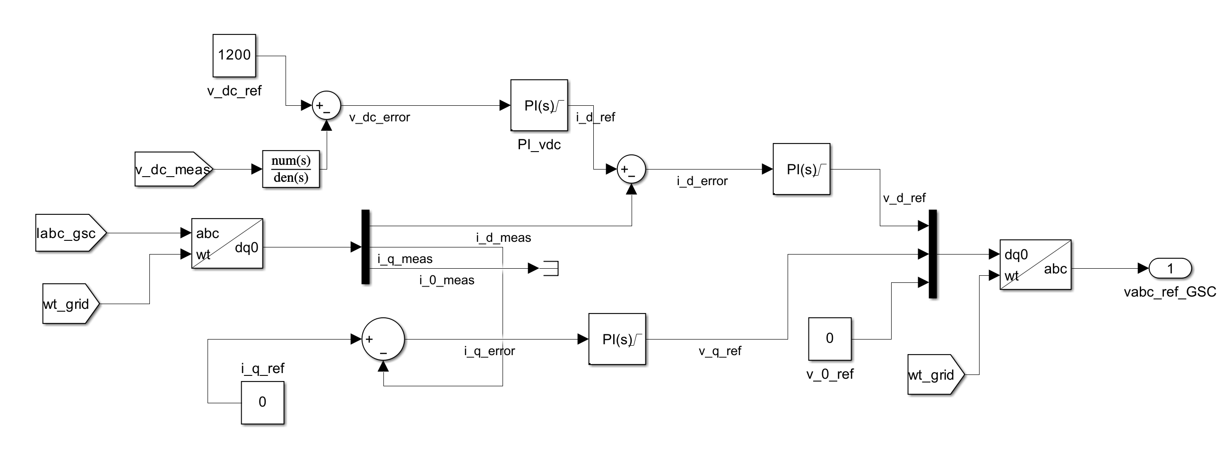
Grid side control scheme
Grid side control scheme . Source [own]. 06.12.2024
Aiswarya Vijayan

Slide 9
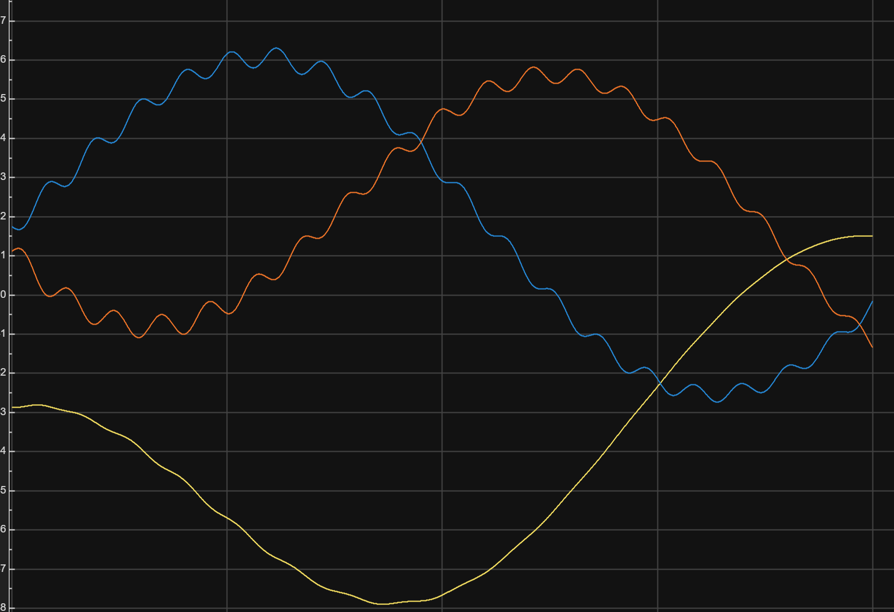
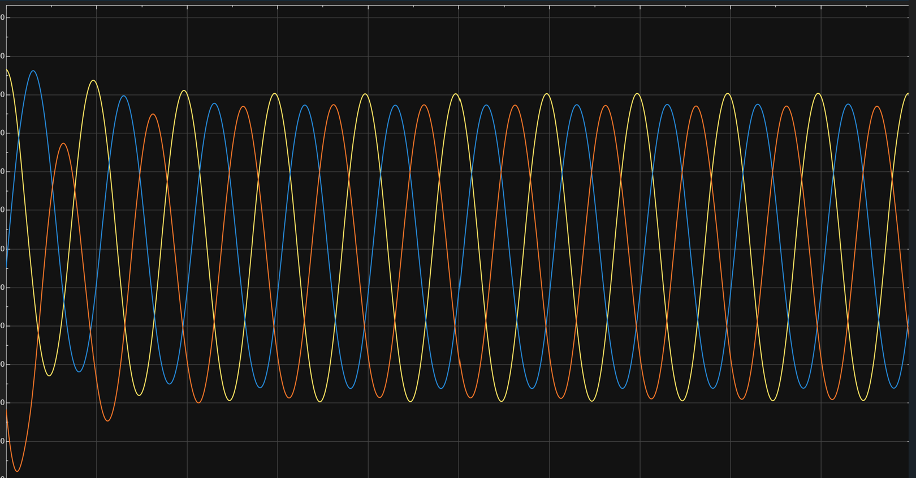
Output signals
Converter output current . Source [own]. 08.12.2024
Converter output voltage . Source [own]. 08.12.2024
Aiswarya Vijayan

Slide 10
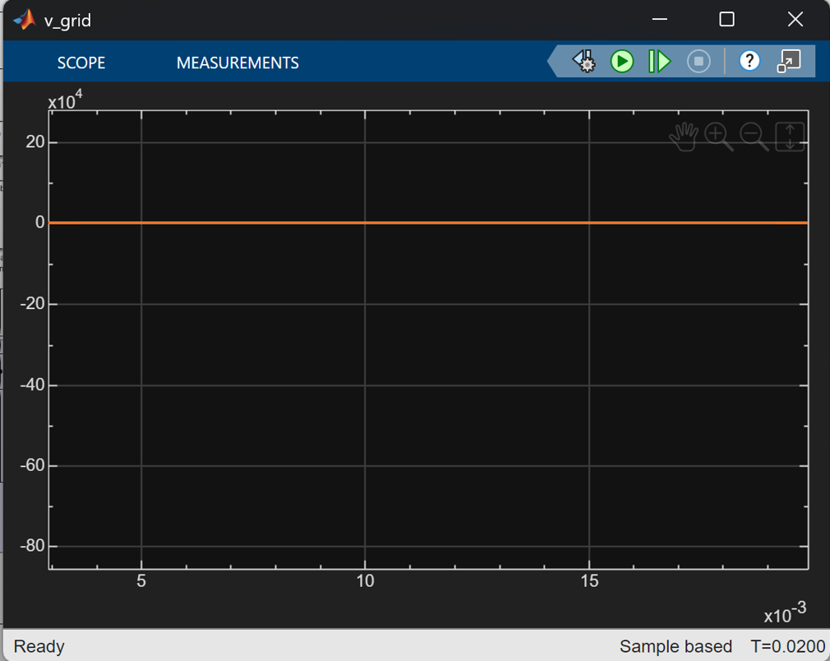
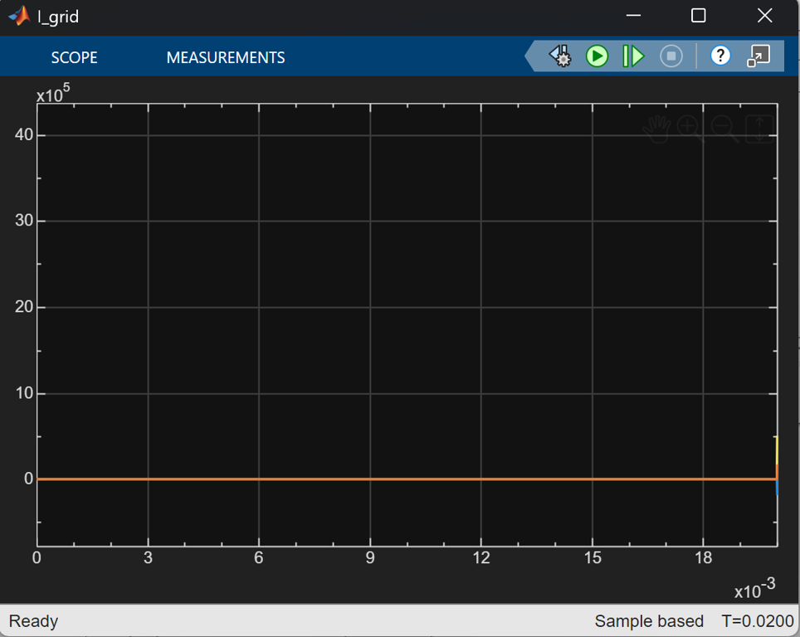
Output signals
DC link voltage . Source [own]. 08.12.2024
DC link current. Source [own]. 08.12.2024
Aiswarya Vijayan

Slide 11
Final cable selection
NA2XS2Y (Al) 95 mm²
Aiswarya Vijayan

Slide 12
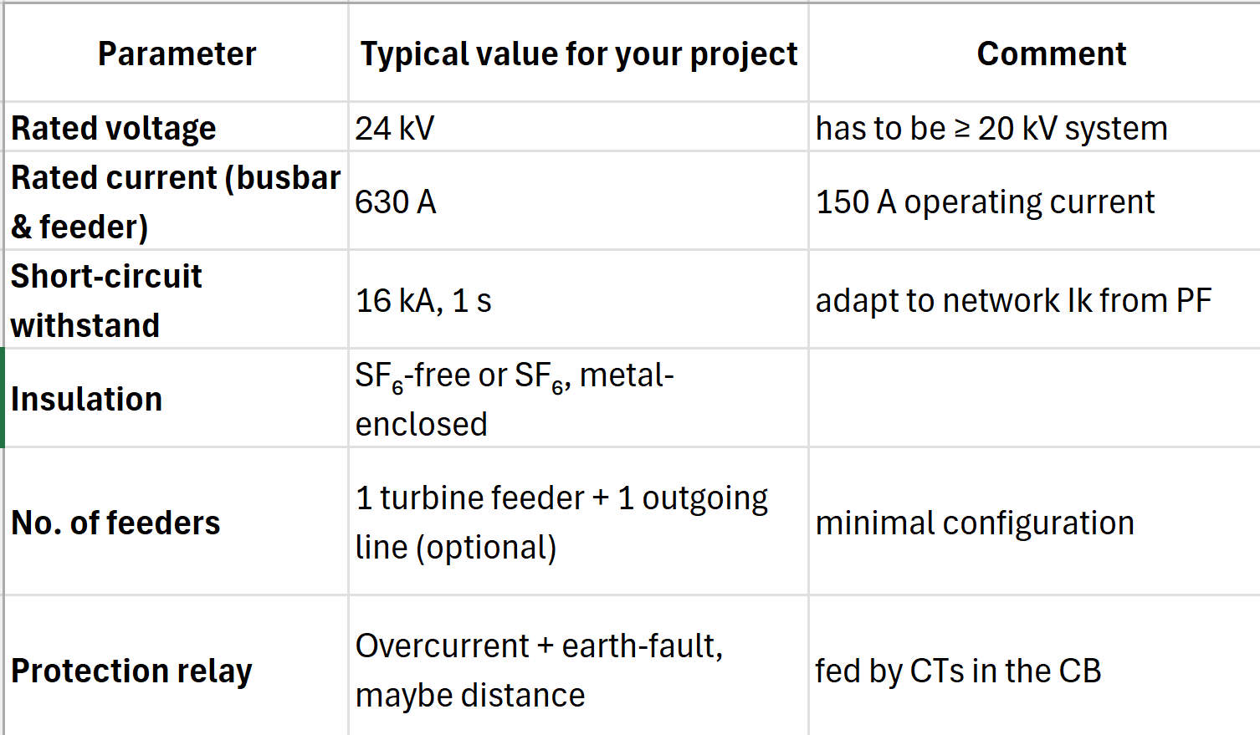
Switchgear
Aiswarya Vijayan

Slide 13
6.Next Step
To finalize the simulation for all components combined.
To start the redaction of report and final presentation.
Aiswarya Vijayan

Slide 14

Bibliography
1. Electrical machines and power electronics course Prof.Dr.-Ing Rajesh Saiju,
2. Power system analysis by hadi saadat. [ 13.12.2025]
3. Electrical engineering for wind turbines course of Prof. Dr. Ingmar Leise. [ 11.12.2025]
4. H. A. Hussain, J. Loncarski, L. B. Ristic, and A. Bellini, “DFIG-Based WECS with Partial-Scale Converter: Efficiency, cost, and volume comparison of SIC-Based and IGBT-Based converter solution,” IEEE Access, vol. 12, pp. 89908–89920, Jan. 2024, doi:https://doi.org/10.1109/access.2024.3419810 [09.12.2025]
5. ABB, “Wind turbine converters,” ABB Power Converters and Controllers Products, Jan. 2025. [Online]. Available: https://new.abb.com/power-converters-inverters/wind-turbines.809.12.2025]
6. Hopewind Electric Co., Ltd., “Wind Power Generation System Product Catalog,” Nov. 2022. [Online]. Available: https://pt.hopewind.com/bocupload/2022/11/24/166926457699or15g.pdf.[09.12.2025]
7. J. Loncarski, H. A. Hussain, T. Taluo and L. Ristic, “BDFRG Based WECS With Partial-Scale Converter: Efficiency, Cost and Volume Comparison of SiC-Based and IGBT-Based Converter Solution,” in Proc. 2023 IEEE Belgrade PowerTech, Belgrade, Serbia, Jun. 2023.[14.12.2025]
8. M. Abdelateef Mostafa, E. A. El-Hay and M. M. ELkholy, “Recent Trends in Wind Energy Conversion System With Grid Integration Based on Soft Computing Methods,” *Archives of Computational Methods in Engineering*, vol. 30, 2023. [14.12.2025]
16/12/2025
14
Aiswarya Vijayan

